Slide 1
Employee salary prediction using simple linear regression
Presented by: Mary Mbugua
Course: Data analysis and AI fundamentals
Institution: MediaCrest Training College

Slide 2
Introduction
Employee salary prediction is a common application of machine learning.
Organizations analyzes salary trends to support fair compensation and workforce planning.
This project uses Simple Linear Regression to predict employee salary based on years of work experience.

Slide 3
Objectives
To develop a Simple Linear Regression model for predicting employee salaries.
Specific Objectives
Load and explore the dataset.
Select predictor and target variables.
Train a Simple Linear Regression model.
Predict employee salaries.
Evaluate model performance.

Slide 4
Dataset description
The dataset contains two variables:
Independent variable (X) – Years of experience
Dependent variable (Y) - Salary

Slide 5
Methodology
Imported the dataset using Pandas.
Explored the data and checked for missing values.
Selected Years of Experience as the predictor.
Split data into training and testing sets.
Trained the Simple Linear Regression model.
Generated salary predictions.
Load Data → Explore Data → Split Data → Train Model → Predict Salary

Slide 6
Regression Model
Simple linear regression – the model learn the relationship between years of experience and salary.
Regression Equation
Salary=25,321.58+9,423.82×(Years of Experience)
Intercept: Predicted salary at 0 years of experience = 25,321.58.
Slope: Each additional year of experience increases the predicted salary by approximately 9,423.82.

Slide 7
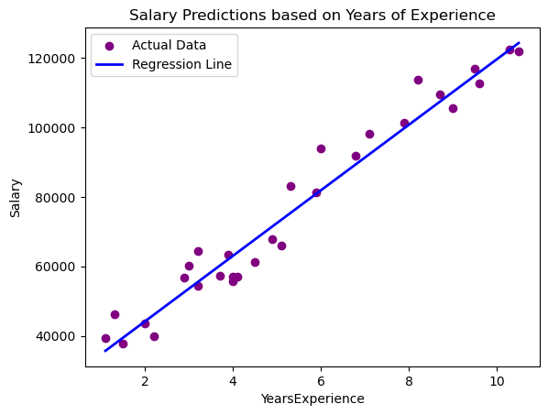
Regression line

Slide 8
Results
The model identified a positive relationship between experience and salary from the upward sloping regression line
Salary increases as years of experience increase.
The model successfully predicted salaries for new employees

Slide 9
Conclusion
Simple Linear Regression successfully predicted employee salaries.
Years of experience is an important predictor of salary.
The model provides useful salary estimates.
More variables could improve prediction accuracy.

